Slide 1

Applied Causal Inference Powered by ML and AI
Vasilis Syrgkanis
MS&E, Stanford

Slide 2
A Data Science Tail
Credit: joint blogpost with Scott Lundberg, Eleanor Dillon, Jacob LaRiviere and Jonathan Roth

Slide 3

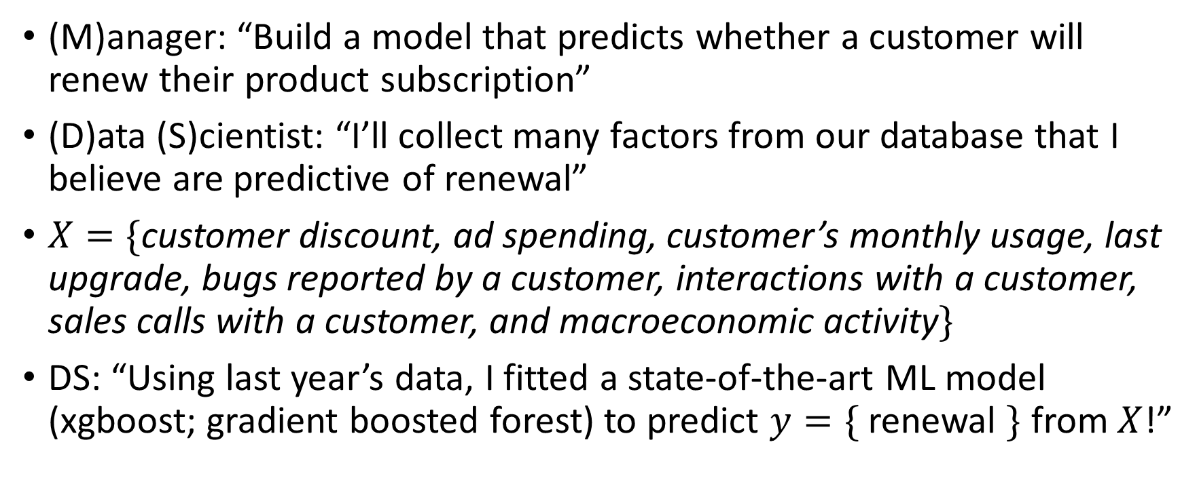
Somewhere in the world right now…
(M)anager: “Build a model that predicts whether a customer will renew their product subscription”
(D)ata (S)cientist: “I’ll collect many factors from our database that I believe are predictive of renewal”
$X=\{$customer discount, ad spending, customer’s monthly usage, last upgrade, bugs reported by a customer, interactions with a customer, sales calls with a customer, and macroeconomic activity$\}$
DS: “Using last year’s data, I fitted a state-of-the-art ML model (xgboost; gradient boosted forest) to predict $y=\{$ renewal $\}$ from $X$!”

Slide 4
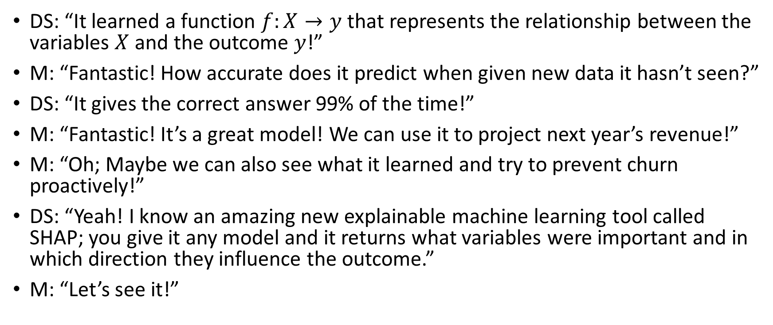
So what…
DS: “It learned a function $f:X→y$ that represents the relationship between the variables $X$ and the outcome $y$!”
M: “Fantastic! How accurate does it predict when given new data it hasn’t seen?”
DS: “It gives the correct answer 99% of the time!”
M: “Fantastic! It’s a great model! We can use it to project next year’s revenue!”
M: “Oh; Maybe we can also see what it learned and try to prevent churn proactively!”
DS: “Yeah! I know an amazing new explainable machine learning tool called SHAP; you give it any model and it returns what variables were important and in which direction they influence the outcome.”
M: “Let’s see it!”

Slide 5
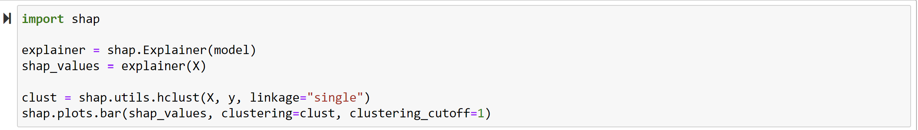
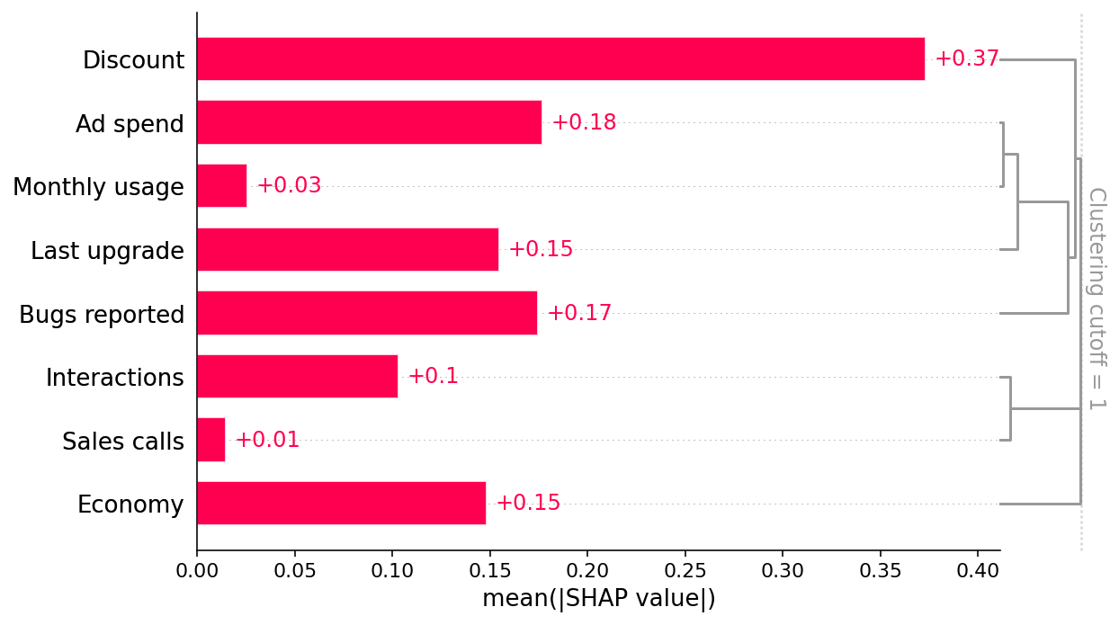
The important factors
DS: “It seems that discounts and ad spend are important! Also bugs!”
M: “Great let’s see how much each one affects the outcome?”

Slide 6
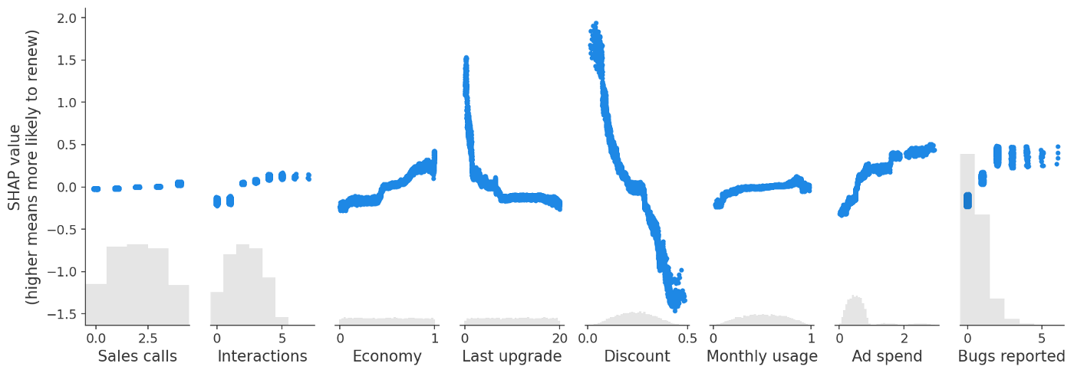
The awkwardness
DS: “So larger discounts reduces renewal! Also, more bugs lead to renewal! Oh, and ads are very important!”
M: “Great let’s increase prices, add more bugs and spam everyone!”

Slide 7
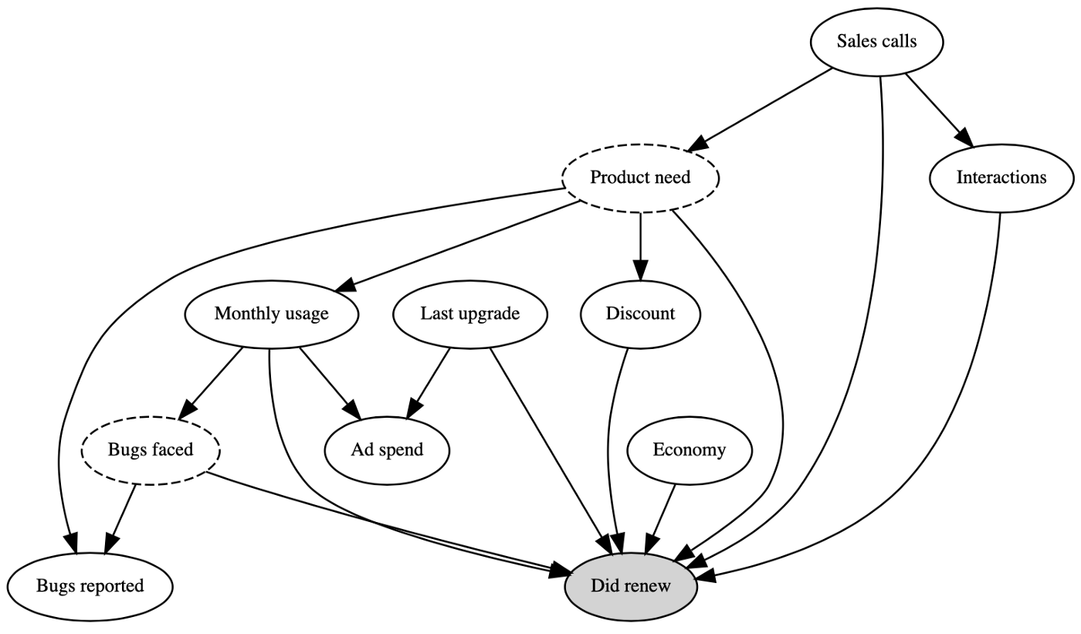
What happened?
Business expert:
“Users with high usage who value the product are more likely to report bugs and to renew their subscriptions.”
“The sales force tends to give high discounts to customers they think are less likely to be interested in the product, and these customers have higher churn.”

Slide 8
Are the counter-intuitive relationships that the model learned problematic?

Slide 9
It depends
If our goal was to simply project next year’s revenue (without any intervention), then these relationships are not problematic
Such tasks that ask for “projecting” some outcome variable in the absence of any intervention are “predictive tasks”
If our goal is to understand what would happen if we intervene in one of the variables to increase retention, then these relationships are problematic
Such tasks that ask for “what-if” or “counterfactual” values of an outcome under some intervention are “causal tasks”

Slide 10
Causal/Interventional Question
20%
?

Slide 11
How do we answer causal questions?

Slide 12
Experiments: The ideal solution

Slide 13
Why the ideal
By randomizing the treatment have two populations that are statistically indistinguishable other than that they differ in the assigned treatment
Any statistical differences in the outcome between the two populations can then safely be attributed to the treatment

Slide 14
What would an A/B test do?
Coin flip discount
?
?
Coin flip bugs
?

Slide 15
Limitations
Ethical
Practical
Generalizability

Slide 16
Observational data and studies

Slide 17
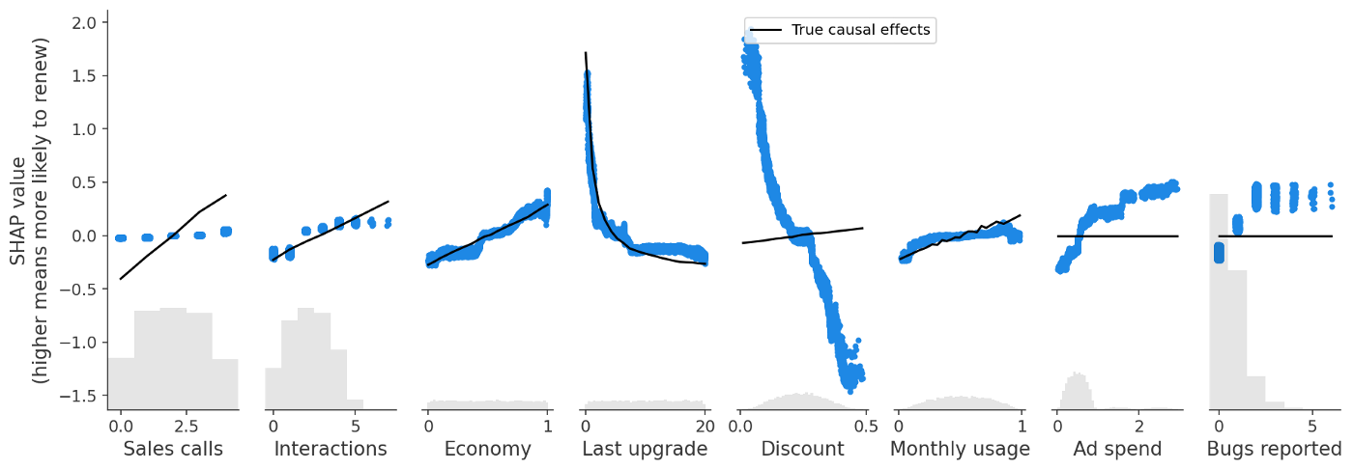
Require domain knowledge
of the high-level mechanisms that underlie the data collection process
?
?
?

Slide 18
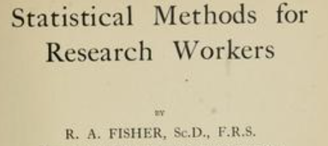
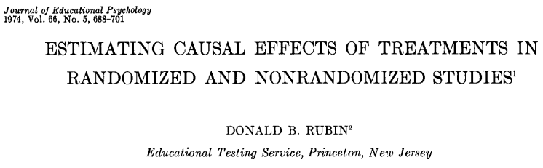

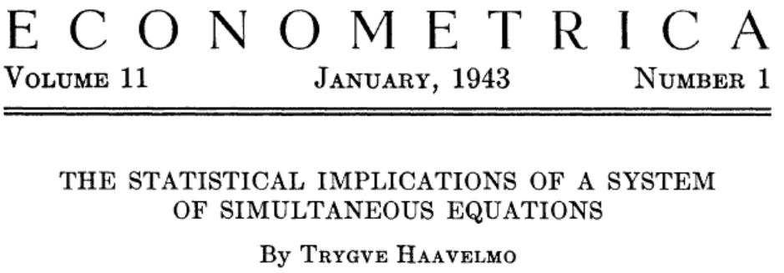

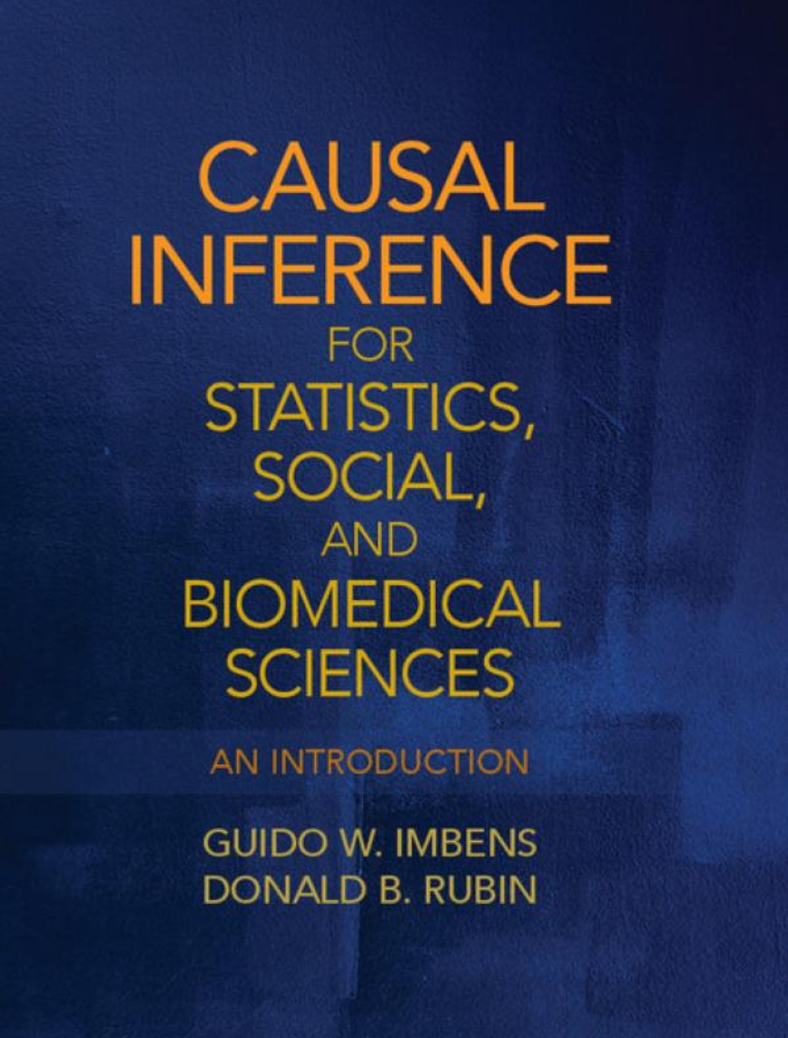
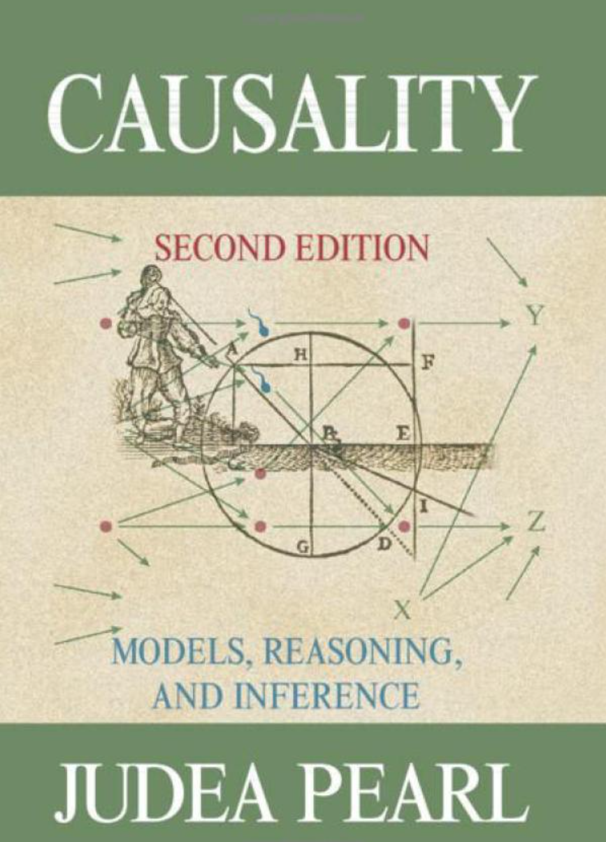
Causal Inference
Addresses interventional (what-if) statistical questions and the identification of causal relationships from data

Slide 19
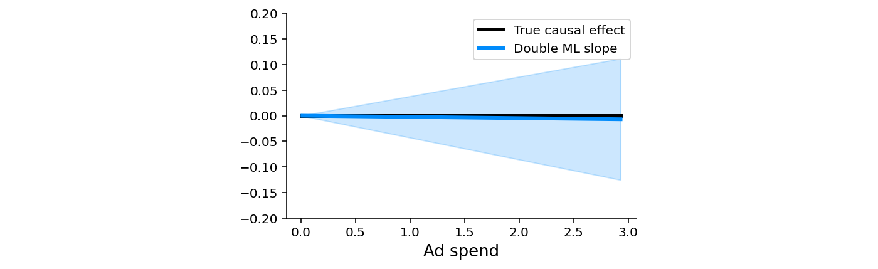
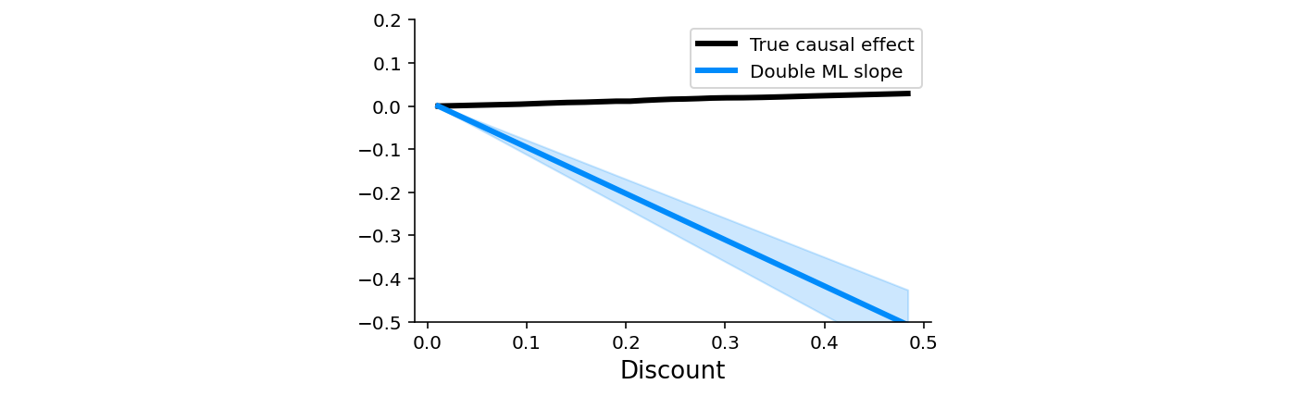
Require domain knowledge
of the high-level causal mechanisms that underlie the data collection process
?
?
?

Slide 20
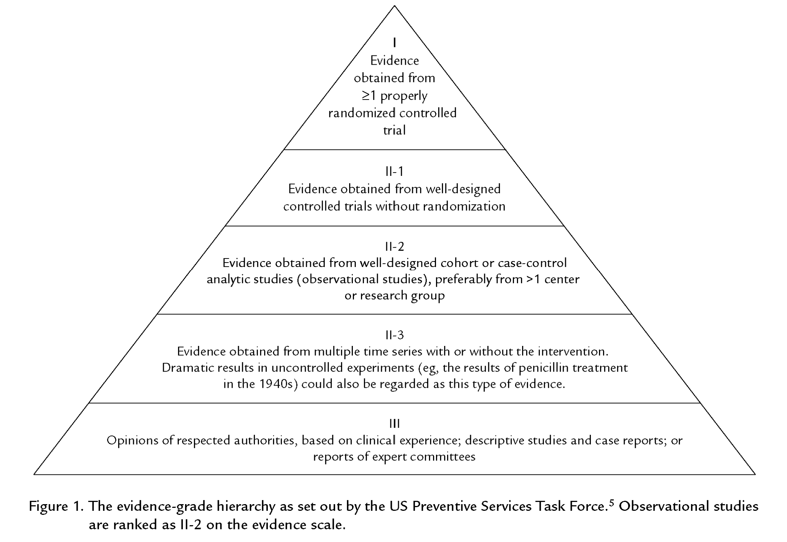
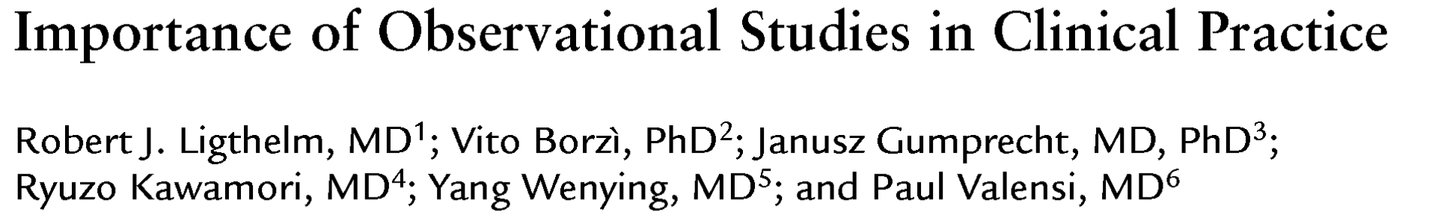
The hierarchy of evidence

Slide 21
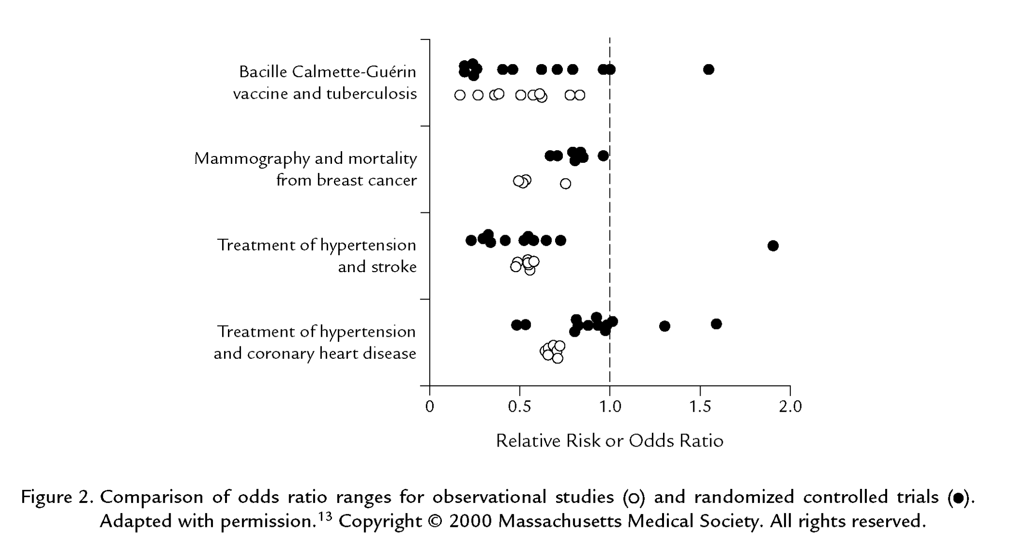
The immense improvement in observational techniques

Slide 22
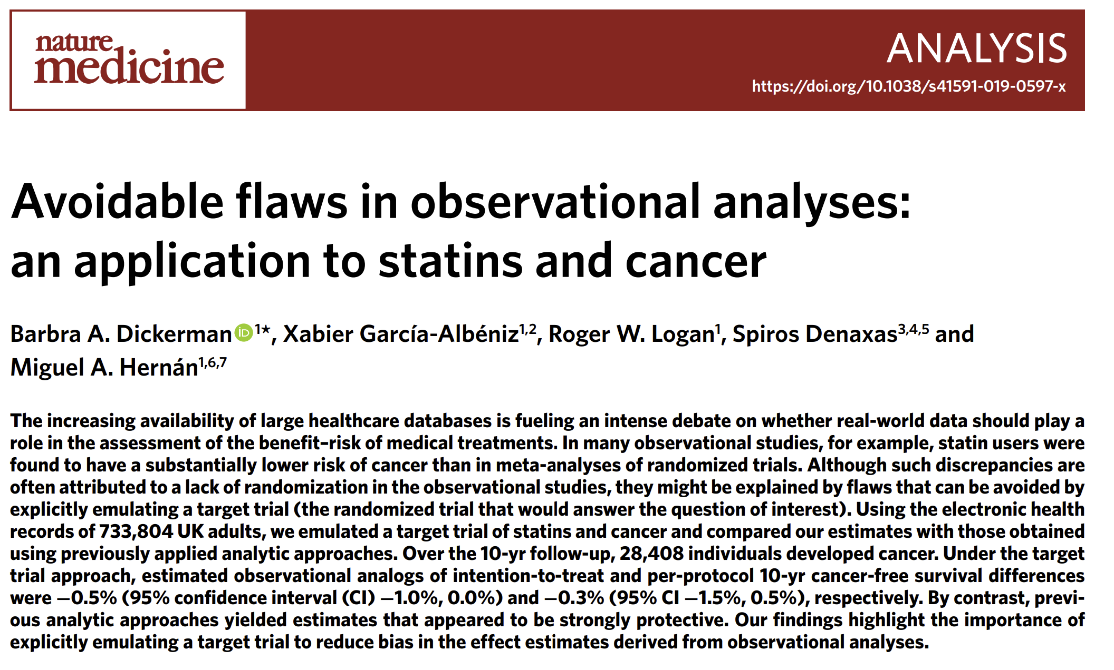
The pitfalls
Conclusions hinge on validity of assumptions
Data quality is much more questionable in observational studies

Slide 23
What is new

Slide 24
Richer datasets (small data) and high-dimensionality
Larger datasets (big data) and the desire for personalization
Advancement of modern predictive machine learning and large-scale computation
Desire for more robust and flexible analysis even in classical datasets

Slide 25
Causal Machine Learning
Re-directing the ability of machine learning estimators to bypass the curse of dimensionality, from the current focus of solving prediction problems to solving statistical problems that arise in causal inference.

Slide 26
Many industrial and scientific use cases
Return-on-investment, pricing, customer segmentation and personalization
Digital experimentation, online ad targeting
Personalized medicine
Heterogeneity of effect in social science studies

Slide 27
Modern case studies

Slide 28

Example 1: Digital Recommendation A/B Tests
Through the lens of a Case-Study at TripAdvisor

Slide 29
TripAdvisor Membership Problem
What is the causal effect of becoming a member on TripAdvisor on downstream activity on the webpage?
How does that effect vary with observable characteristics of the user?
Useful for understanding the quality of membership offering/improvements/targeting
Notes:
With TripAdvisor, we wanted to answer the following problem:
what is the causal effect of becoming a member on TripAdvisor on downstream activity on the webpage and
how does that effect vary with observable characteristics of the user
An answer to this problem can be useful to understand the quality of the membership offering, make improvements and target segments of the user base to incentivize membership.
1.10-1.30

Slide 30
TripAdvisor Membership Problem
What is the causal effect of becoming a member on TripAdvisor on downstream activity on the webpage?
How does that effect vary with observable characteristics of the user?
Useful for understanding the quality of membership offering/improvements/targeting
Standard approach: Let’s run an A/B test!
Not applicable: We cannot enforce the treatment!
We cannot take a random half of the users and make them members
Membership is an action that requires user engagement!
Notes:
The standard approach that the tech industry takes to address such questions is to run an A/B test.
Unfortunately, an A/B test is not feasible here, since we cannot enforce the treatment.
We cannot take a random half of the users and make them members.
Membership is an action that requires user engagement.
1.30 - 2

Slide 31
Recommendation A/B Tests
In optimizing a service we want to understand the causal effects of actions that involve user engagement (e.g. becoming a member)
Notes:
And this is a problem that many companies are facing:
when optimizing a service, many times you want to understand the causal effects of actions that involve user engagement.
2 – 2.10

Slide 32
Recommendation A/B Tests
In optimizing a service we want to understand the causal effects of actions that involve user engagement (e.g. becoming a member)
We can run a recommendation A/B test:
“recommend/create extra incentives” to half the users to take the action/treatment
Example at TripAdvisor: enable an easier sign-up flow process for a random half of users
Notes:
Even though one cannot run a traditional A/B test, we can still run a “recommendation A/B test”:
we can recommend or create extra incentives for a random half of users to take the action or treatment.
For example in the TripAdvisor problem we can enable an easier sign-up flow process for a random half of the users.
2.10-2.30

Slide 33
Recommendation A/B Tests
In optimizing a service we want to understand the causal effects of actions that involve user engagement (e.g. becoming a member)
We can run a recommendation A/B test:
“recommend/create extra incentives” to half the users to take the action/treatment
Example at TripAdvisor: enable an easier sign-up flow process for a random half of users
Non-Compliance: ``user’s choice to comply or not`` can lead to biased estimates
Notes:
However, recommendation A/B tests pose an extra difficulty as compared to standard A/B tests.
The fact that users choose themselves to comply or not with the recommendation, leads to potential unobserved confounding
Hence, we run the risk of getting biased estimates if we treat the resulting data as if they came from a classical A/B test.
2.30-2.50

Slide 34
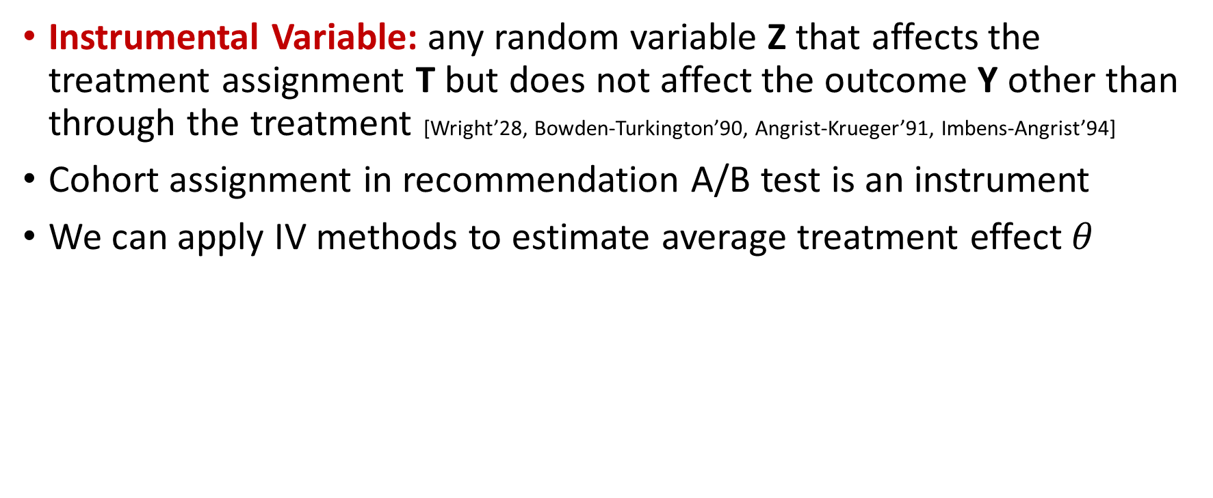
Instrumental Variables (IV)
Instrumental Variable: any random variable Z that affects the treatment assignment T but does not affect the outcome Y other than through the treatment [Wright’28, Bowden-Turkington’90, Angrist-Krueger’91, Imbens-Angrist’94]
Cohort assignment in recommendation A/B test is an instrument
We can apply IV methods to estimate average treatment effect $θ$
Notes:
Here is where econometric techniques can prove very useful.
We can view the cohort assignment in a recommendation A/B test as an instrument, since it is a random variable that affects the treatment assignment but does not affect the outcome of interest other than through the treatment assignment.
Thus we can apply IV methods in order to estimate the average effect of becoming a member.
2.50-3.20

Slide 35
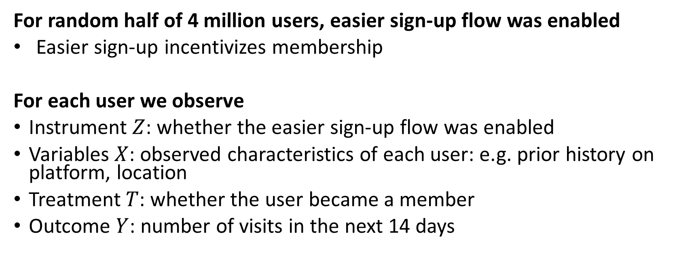
TripAdvisor Experiment
For random half of 4 million users, easier sign-up flow was enabled
Easier sign-up incentivizes membership
For each user we observe
Instrument $Z$: whether the easier sign-up flow was enabled
Variables $X$: observed characteristics of each user: e.g. prior history on platform, location
Treatment $T$: whether the user became a member
Outcome $Y$: number of visits in the next 14 days
Notes:
This is what TripAdvisor did.
They run a recommendation A/B test, where for a random half of 4 million users, they enabled an easier sign-up process.
Easier sign-up incentivizes membership.
After the experiment we observe for each user:
Whether the easier sign-up process was enabled
Several characteristics of the user, such as prior history on the platform or geolocation
Whether the user ended up becoming a member, in other words, whether they took the treatment
And the outcome of interest, which in this case was chosen as the number of visits in the next 14 days.
3.20 – 4

Slide 36
Example 2: Long-term effects of new treatments
Through the lens of a Return-on-Investment (ROI) Case-Study at Microsoft

Slide 37
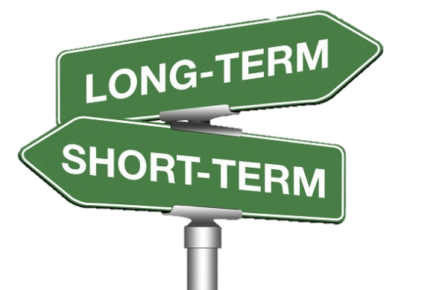
Estimating Long-Term Returns on Investment
Companies frequently deploy new discount or customer support programs
Which of these programs (“investments”) are more successful than others?
Success is a long-term objective: what is the effect of the program on the two-year customer journey (e.g., effect on two-year revenue)
We cannot wait two years to evaluate a program
Main Question. Can we construct estimates of the values of these programs with short-term data, e.g. after 6 months?

Slide 38

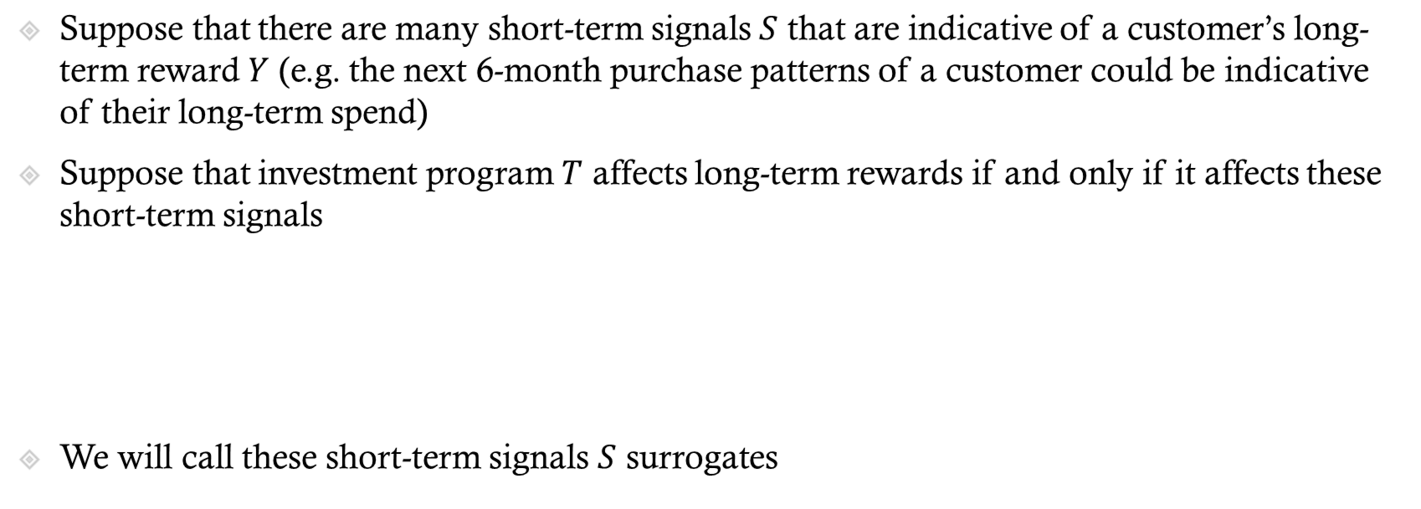


Long-Term Effects from Short-Term Surrogates
Suppose that there are many short-term signals $S$ that are indicative of a customer’s long-term reward $Y$ (e.g. the next 6-month purchase patterns of a customer could be indicative of their long-term spend)
Suppose that investment program $T$ affects long-term rewards if and only if it affects these short-term signals
We will call these short-term signals $S$ surrogates
$T$
$S$
$Y$

Slide 39


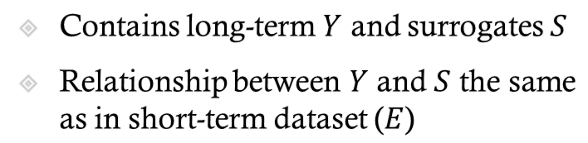


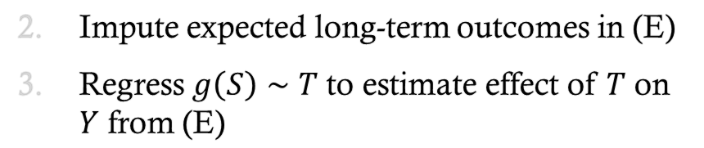

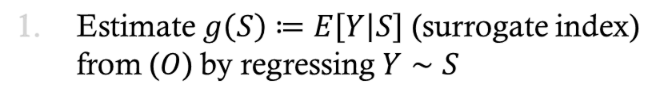

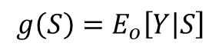
Causal Inference with Surrogates 101
historical/long-term (O)
recent/short-term (E)
Contains long-term $Y$ and surrogates $S$
Relationship between $Y$ and $S$ the same as in short-term dataset ($E$)
$$T$$
$$T$$
$$S$$
$$Y$$
$$S$$
$$Y$$
$$g\left(S\right)=E_{o}\left[Y | S\right]$$
Estimate $g\left(S\right)≔E\left[Y | S\right]$ (surrogate index) from ($O$) by regressing $Y∼S$
Impute expected long-term outcomes in (E)
Regress $g\left(S\right)∼T$ to estimate effect of $T$ on $Y$ from (E)

Slide 40

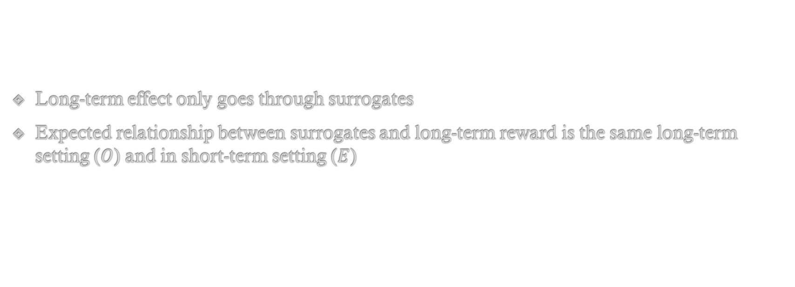
Key Assumptions
Long-term effect only goes through surrogates
Expected relationship between surrogates and long-term reward is the same long-term setting ($O$) and in short-term setting ($E$)

Slide 41
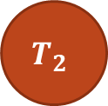




Key Assumptions can be Easily Violated Investment policies are dynamic and change
historical/long-term (O)
recent/short-term (E)
$$T_{1}$$
$$T_{2}$$
$$T_{1}^{new}$$
$$S$$
$$Y$$
$$S$$
$$Y$$
We deployed older/deprecated investments
In a potentially long-term highly auto-correlated manner
Investments are potentially adaptive
Investment policies change

Slide 42
Example 3: Genomic data
Effect of genetic interventions on effectiveness of cancer therapies

Slide 43
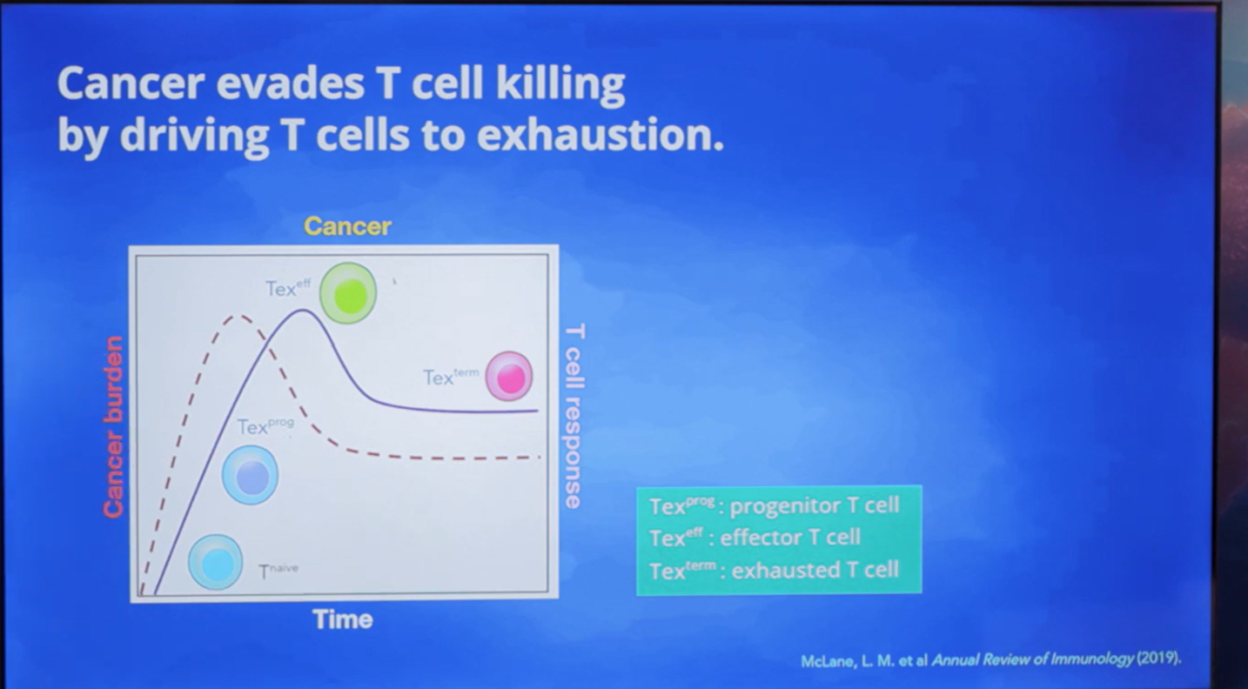
Cancer Immunotherapy Data Science Grand Challenge
Centers on the question of how to make T cells better at killing cancer cells
The Eric and Wendy Schmidt Center at the Broad Institute of MIT and Harvard and other collaborators
While scientists have tested some genetic modifications to T cells in the lab, there are too many possible
Bring ML to this problem to help identify which “perturbations” could make cancer immunotherapy more effective

Slide 44
Data
4,978 unperturbed cells and 26,031 perturbed cells
Each perturbation is one of 73 different CRISPR single gene knockouts
For each cell: a 15,077-dimensional gene expression vector and its condition ('unperturbed' or the name of the gene knockout)
Each cell classified (by experts) into one of 5 cell states ('progenitor', 'effector', 'terminal exhausted', 'cycling', 'other’)
State is related to the effectiveness of a knockout for cancer immunotherapy

Slide 45
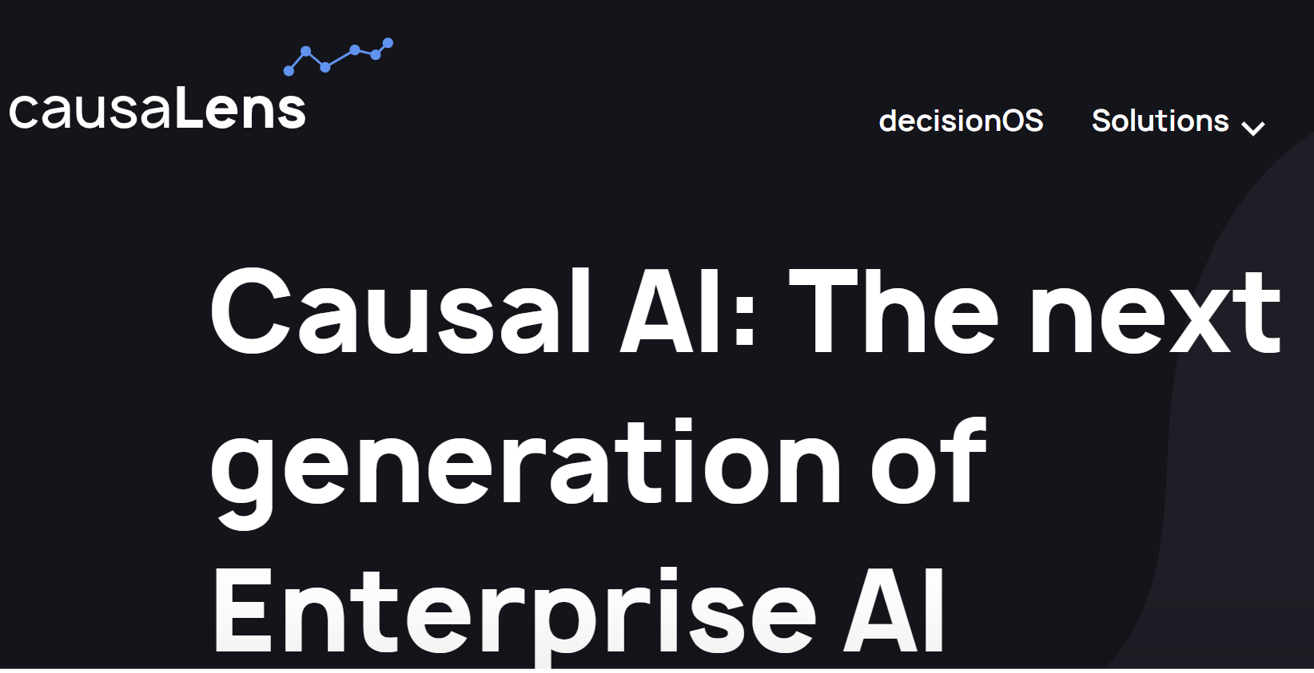

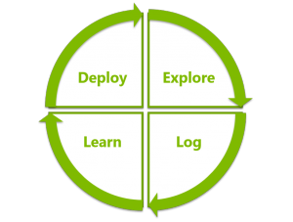

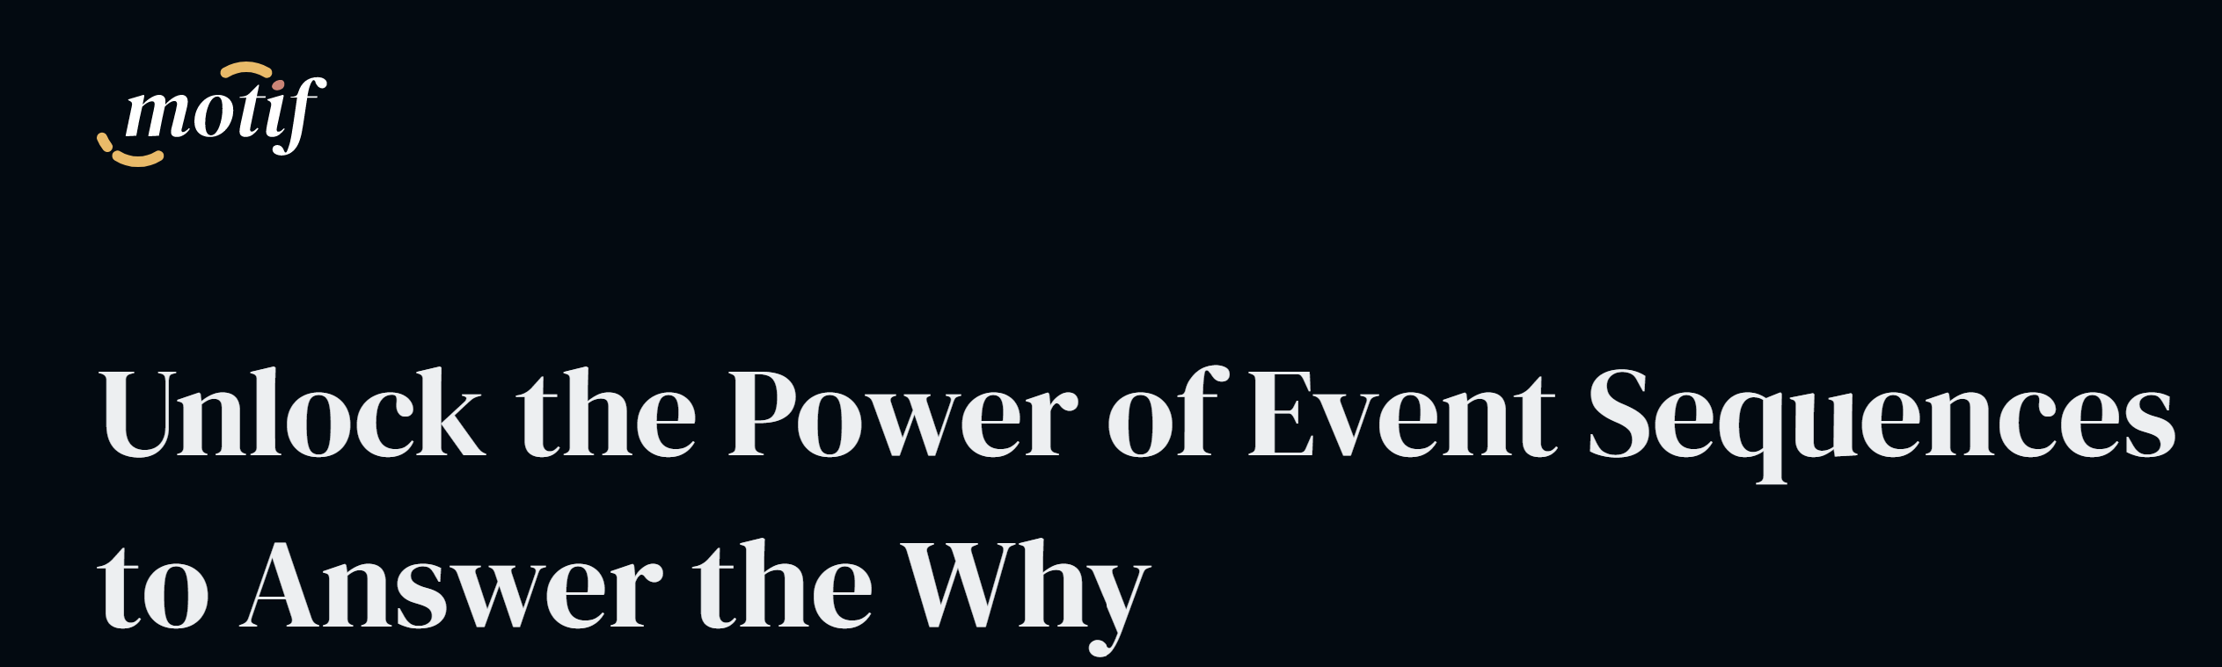







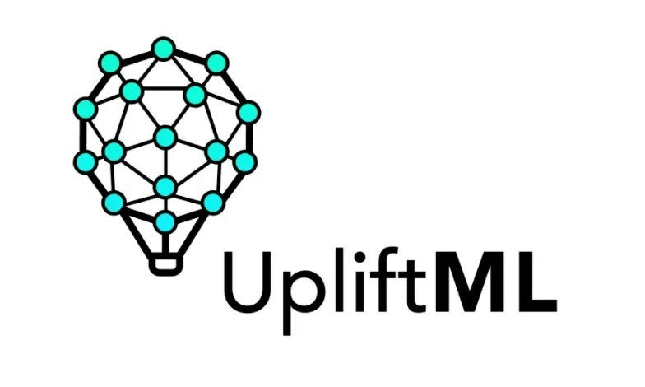
A Growing Software Tool EcoSystem
Data Collection
Identification Strategy
Estimation/Inference
Sensitivity Analysis
Active data collection
Domain Assumption Elicitation
Interpretation/Policy Recommendations
Validation
Decision Service
(Contextual Bandits)
ShowWhy
DoWhy
DoWhy
tlverse
grf-labs
Auto-Causality

Slide 46
What we hope you’ll take away

Slide 47
Goals of the class
Learn if and how you can identify causal effects from a dataset
Learn how to properly use Machine Learning in causal estimation
Practical experience implementing Causal ML methods in Python
Practical experience applying Causal ML methods in real world datasets from social sciences, healthcare, tech

Slide 48
Structure and rough outline

Slide 49
Lecture Outline
Section 1: Experiments
Section 2: Estimation and inference with linear models in high-d
Section 3: Observational data, causality, DAGs, structural equations
Section 4: Estimation and inference with modern non-linear ML methods
Section 5: Unobserved confounding and instruments
Section 6: Heterogeneous Effects and Policy Learning
Section 7: Further topics (e.g. Diff-in-Diff, Regression Discontinuity, Dynamic Treatment Effects)

Slide 50
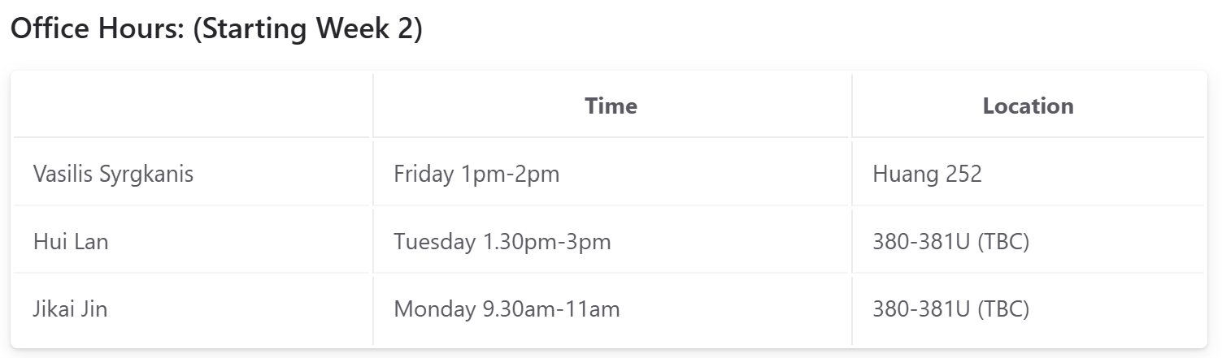
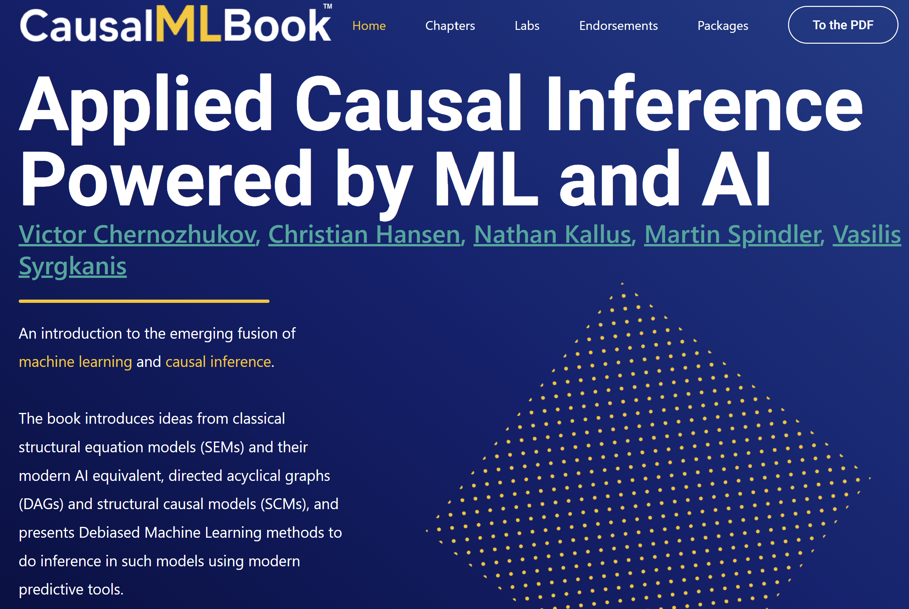
Logistics
Class info: https://stanford-msande228.github.io/winter25/
8 roughly weekly homework assignments (90%)
Class participation (more than half of in-class polls) (10%)
Main text-book: https://causalml-book.org
Discussion: Ed Discussion, Submissions: Gradescope

